Slide 2
- Why do we really need autonomous networked systems; isn't automatic enough?
- Is the world ready for autonomy? If not, why?
- In a world of data/ML/LLMs/Google: what key technology or research step is missing?
- Based on the ideas and innovations shared so far, what has stood out most?
- Communication networks are obvious application areas, but what other domains might ANS apply to?

Slide 3


Slide 4


Why do we really need autonomous networked systems; isn't automatic enough?

Slide 5
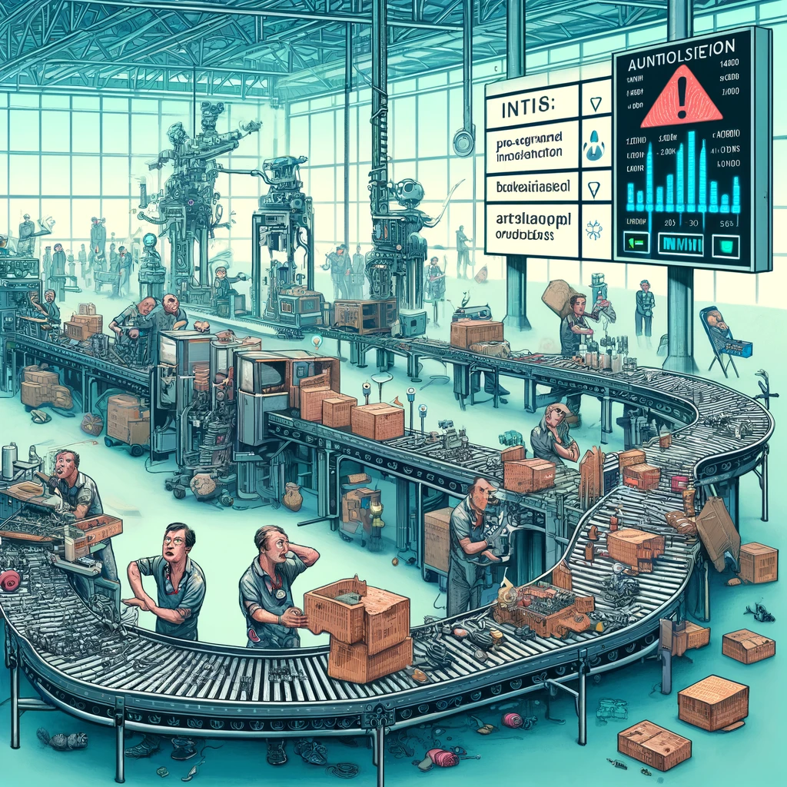
Is the world ready for autonomy? If not, why?

Slide 6

In a world of data/ML/LLMs/Google: what key technology or research step is missing?

Slide 7

Based on the ideas and innovations shared so far, what has stood out most

Slide 8

Communication networks are obvious application areas, but what other domains might ANS apply to?

